Slide 1
Automated LZW Exercise Generation
Generating fair, unique assessment questions for an algorithmics course
Andrew King
Notes:
I’m looking for something to generate fair, unique exam questions for an algorithms course

Slide 2
The Problem
Giving every student the same paper creates potential collusion risk
Composing unique assessment papers manually is time-consuming and hard to calibrate fairly
The challenge: questions need to be varied enough to prevent collusion, but similar enough in difficulty to be fair
Notes:
The problem this dissertation seeks to address

Slide 3
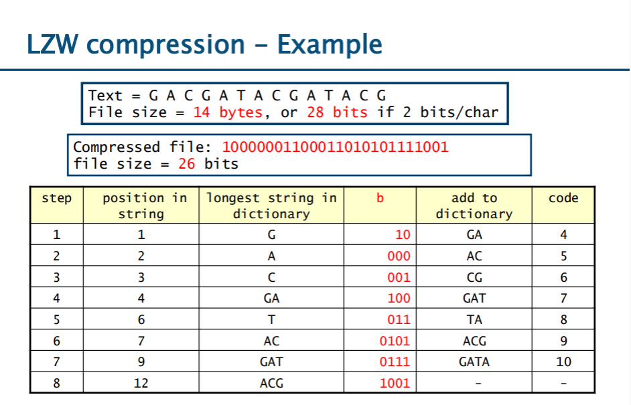
LZW algorithm
Dictionary-based compression algorithm
Initialise dictionary with base alphabet: A=00, C=01, G=10, T=11
Step-by-step execution maps naturally onto an exam table
Notes:
Lempel-Ziv-Welch

Slide 4
Controlling Difficulty
Quantitatively step count and dictionary growth
Statistically Shannon entropy captures character-level predictability H = − Σ p(x) × log₂(p(x))
Perceptually how patterned does the string look to a student?
Notes:
Shannon entropy used to ensure that characters are evenly and randomly distributed
Entropy makes it look more random
Perceptual visual variance makes sure the compression steps required to complete the questions are random

Slide 5
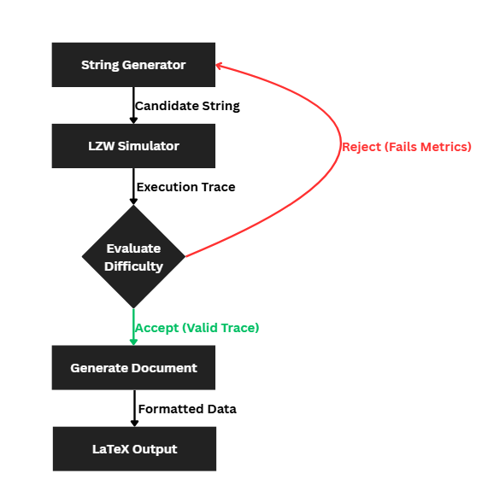
How the Generator Works
Generate-and-filter loop: sample → streak test → simulate → check targets → accept or retry
Up to 100,000 attempts before fallback
Notes:
Show you how to complete it when creating a paper
CHANGE SCREEN TO SHOW WHAT YOU ARE DOING

Slide 6
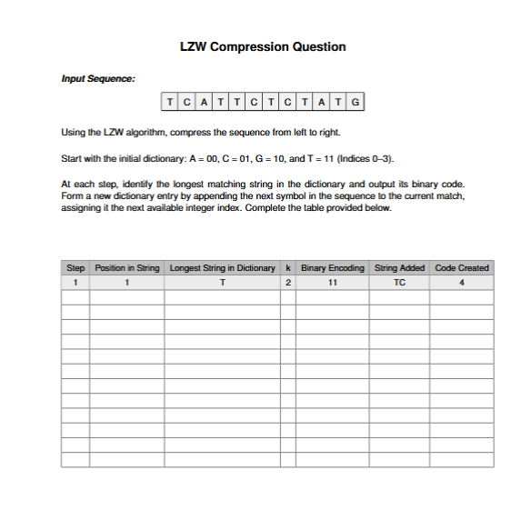
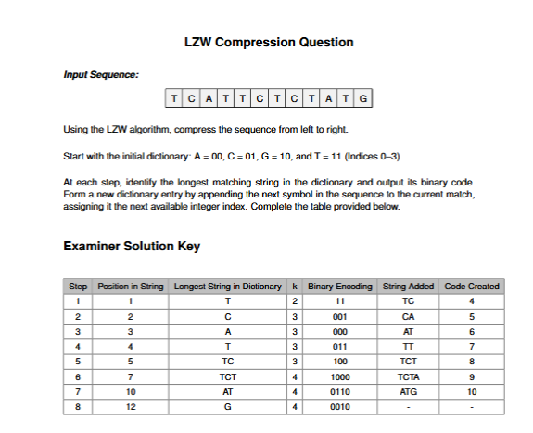
Output
Two exercise types: compression and decompression
Two difficulty profiles: high entropy and low entropy
LaTeX output to slot into existing class test paper workflow
First row pre-filled as worked example
Extra blank rows conceal true step count
Notes:
That will generate on the left a student paper, and on the right, an answer key

Slide 7
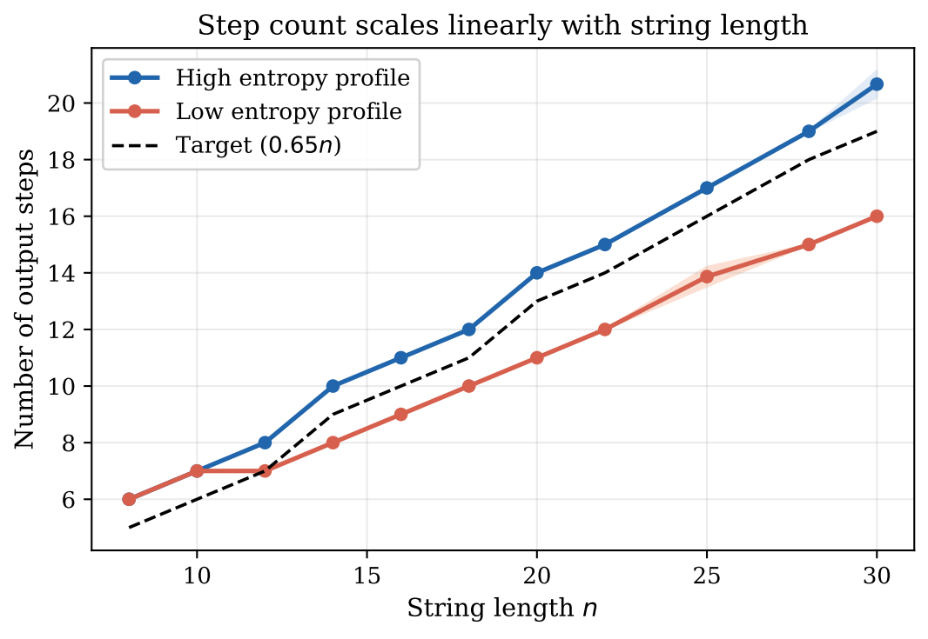
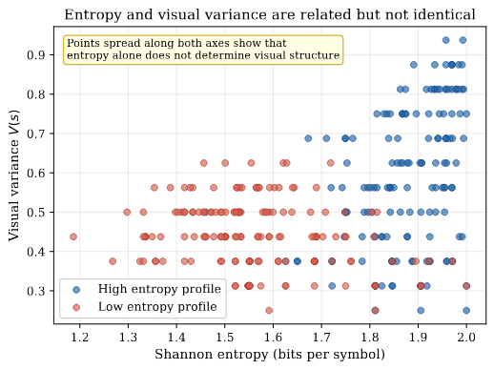
Evaluating the Solution - Quantitative
Notes:
Left hand side table shows how the generator scales linearly – but also the shaded area shows the deviation from what it usually produces – for the main high entropy use case there is no deviation so questions are equal to one another
Meaning fairness is achieved
Shannon entropy of the input string. Further right means more uniformly distributed characters, closer to the maximum of 2 bits. Further left means one character is dominating
Visual variance (in your current system, bigram diversity of the input string). Higher means more distinct adjacent pairs, the string looks more varied. Lower means fewer distinct pairs, the string looks more repetitive.

Slide 8
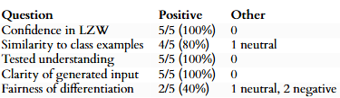
Evaluating the Solution - Qualitative
The question generator was tested the following ways:
Peer usability test confirmed that the question generator was intuitive to use and that difficulty metrics led to fairer difficulty generation
Algorithms course class test conducted using generated questions. Results from student post-test survey shown below:
Notes:
Used the questions in a class test to ensure the generated questions met the criteria and were suitable for their use case
Also to gain insights from a subsequent student survey
Fair to have equally unique and difficult questions
Couldn’t be certain in how the questions are fair in difficulty if they are unsure of how they are changed as there is a degree to how much you can alter a question while claiming equal difficulty
Degree to which you can change a question and claim it is the same difficulty
Can be mitigated by briefing the students ahead of class tests about how questions are randomised
Com pah rah ble

Slide 9
Outcomes & Possible Future Developments
Achieved Outcomes
Generates unique LZW compression and decompression exercises
LaTeX output fit for use in class tests
Students rated exercises as clear, fair, and comparable to class examples
Possible Future Developments
Huffman coding support: similar table-based structure, where the approach can be adapted
Student practice tool to generate personalised revision exercises
Notes:
In conclusion the qualitative and quantitative data indicates that the lzw compression and decompression meets the criteria of the question
Com pah rah ble

